Slide 1
CSE455 - Software Testing
Chapter 5

Slide 2
Dynamic testing
Involves running the software on a computer
Requires an executable test object
Input data is fed to the test driver before execution
Often needs a unit test framework for component testing like JUnit (xUnit)
Uses black-box, white-box, and experience-based techniques
Main goal is to check if requirements are fulfilled and failures found

Slide 3
Purpose of DT
Confirms that requirements are met
Identify any deviation among requirements and implementation
Use as little effort as possible to test as many requirements and identify as many failures as possible

Slide 4
Steps in DT
Define the test conditions and preconditions, and objective you wish to achieve
Specify individual test cases
Define the test execution schedule
Degree of formality of the process depends on the maturity of development and test processes, time constraints and skills of the team members
Traceability between individual requirements and their corresponding test cases enables us to analyze the impact of changes to requirements on the testing process
Designing new test cases, discarding redundant test cases, modifying existing test cases

Slide 5
Steps in DT cont..
Expected results must be defined and documented before test is executed. Violation of this guideline results in an incorrect test result might be interpreted as fault-free, thus allowing a system failure to go unnoticed
Test Execution Schedule
List test cases thematically according to their objectives
Test priorities
Technical/Logical dependencies between tests
Assignment of test cases to individual testers

Slide 6
Unit test framework
Required for testing non-standalone components
An environment for dynamic testing is created by emulating the context of the unit under test
Context of the unit test consist of
Test Driver - Caller of the unit
Stubs – Emulation of all the units called by the unit under test
Together form an executable test setup
Unit under test must be tested in isolation to accurately identify defects
The surrounding environment is emulated to avoid side effects and external influences

Slide 7
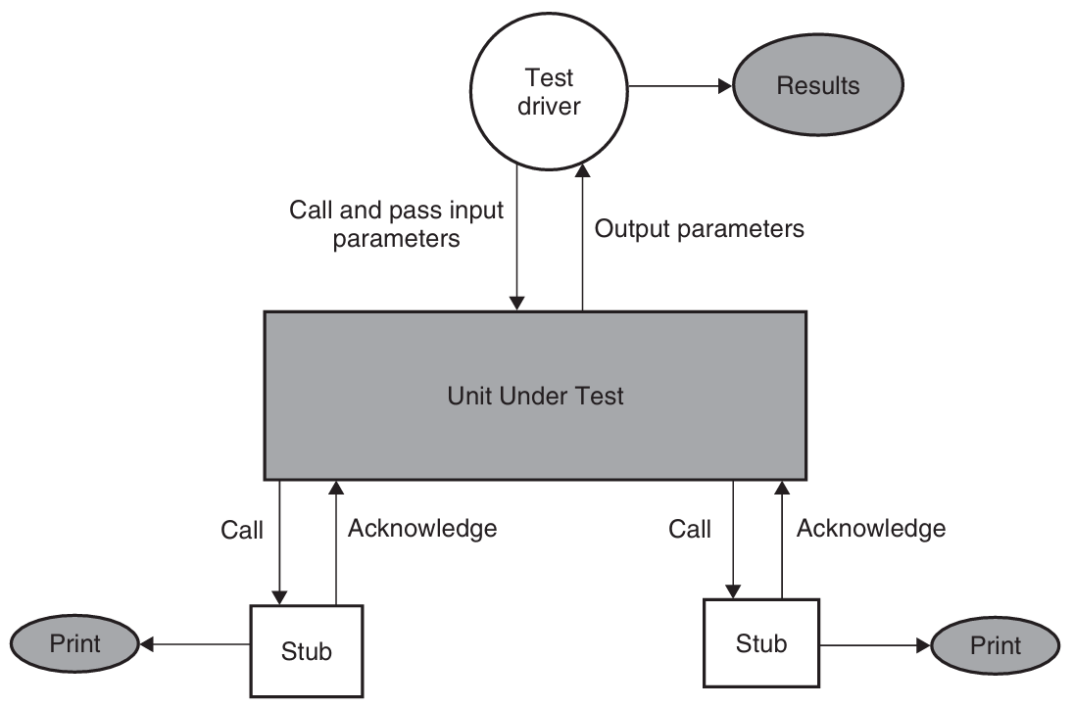

Slide 8
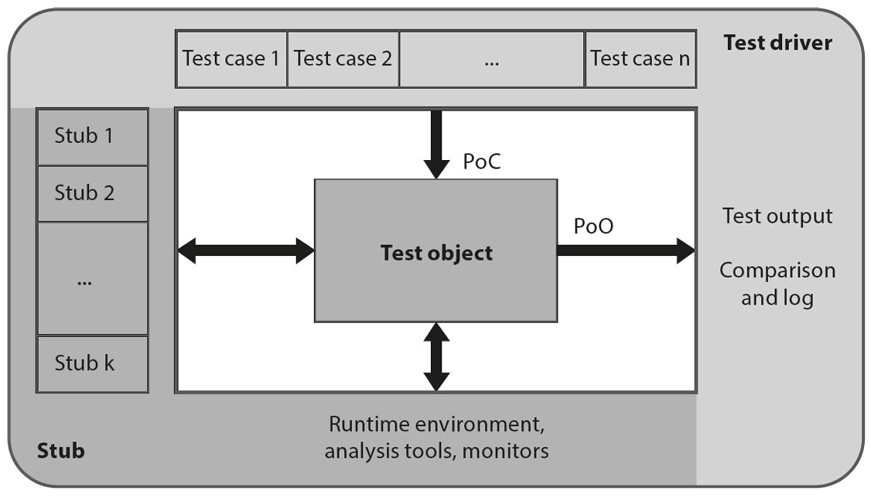

Slide 9
Point of observation and control
Point of control (POC) – where you give input
This is the place in the system where the tester provides input or initiates an action
It is where you control the software behavior by simulating a user or external system
Example:
You enter a username and password into a login form
The input field is a point of control because you are sending data to the system

Slide 10
Point of observation and control
Point of observation (POO) – where you check output
This is the place where you observe the system’s output or reaction to the input
It’s where you check if the result is correct
Example:
After submitting the login form, the system displays a welcome message or an error
This output screen is a point of observation because you observe the result here

Slide 11
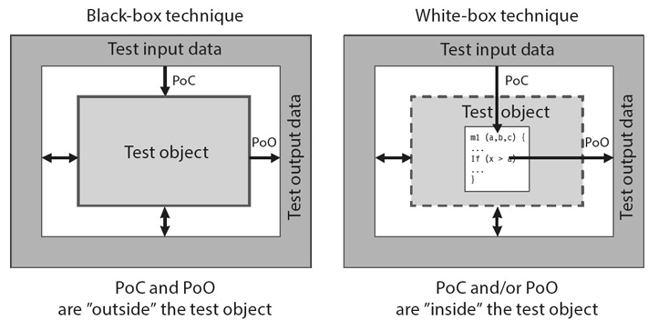

Slide 12
Unit test framework cont..
Test Driver
Calls the unit under test
Supplies input values and checks the actual result against expected output
Acts as the main routine in this isolated environment
Should be self-contained, with no reliance on external input files
Must be capable of checking return values, internal variables, memory issues (leaks, allocation, deallocation), checks for file status (open/closed) and release other unused resources
Stubs
Replaces any unit called by the unit under test (test object)
Minimal implementation:
Print/log a message to confirm invocation
Return precomputed/dummy values to allow the test to proceed

Slide 13
Unit test framework cont..
Each test object must have its own dedicated test driver and stub
A shared test driver across multiple units is discouraged due to
Increased complexity
High coupling
Risk of side effects from future changes
Drivers and stubs are not discarded after initial test
They are
Maintained across the lifecycle of the unit
Reused in regression testing
Update upon code changes, new faults discovered and platform changes

Slide 14
Black box testing
Test cases are derived from specification due to the lack of knowledge about inner working of code
Also known as specification-based or behavior-based testing
All techniques that define test cases before coding (such as test-first/test-driven development) are by black box techniques
Point of observation for a black-box test is outside the test object and you need no knowledge of inner structure
Concentrate solely on the test object’s input and output behavior

Slide 15
Domain testing
Large number of values in the input domain of the program and there are a large number of paths in a program
Partitioning the input into finite number of subdomains and assigning a distinct program path to each of the input subdomains
Program P where D is the domain of entire program which is divided into five subdomains D1,… D5. Part of program that specifies which code to execute for each subdomain is input classifier. Program does different computations for different subsets of its input domain
Domain can be represented by set of predicates

Slide 16

Domain testing cont..
A domain is defined, from a geometric perspective, by a set of constraints called boundary inequalities
Closed boundary – If points on the boundary are included in the domain like P2 in above example
Open boundary – If points on the boundary do not belong to the domain like P1 in the above example
Equality symbol in a relational operator determines whether or not a boundary is closed
Closed domain – All boundaries are closed
Open domain – Some of the boundaries are open

Slide 17
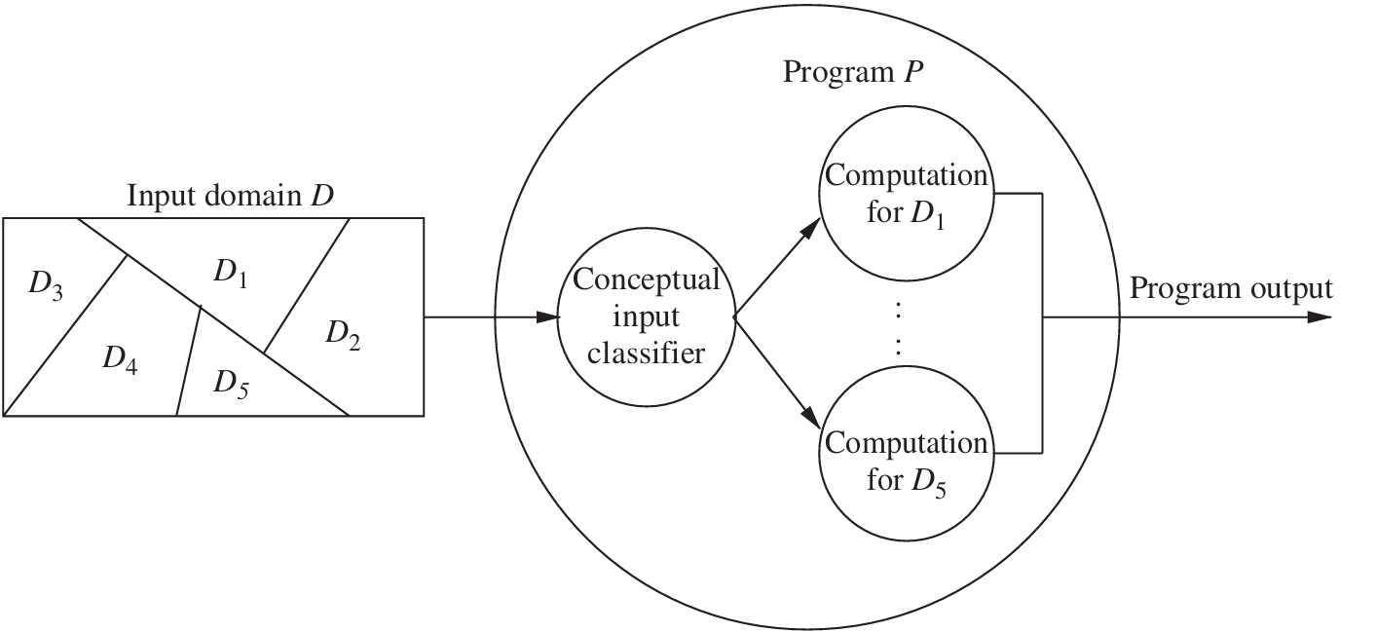

Slide 18
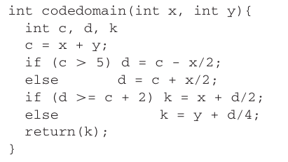
practice
Given two predicates, identify and plot each domain:
P1: x + y > 5
P2: d >= c + 2

Slide 19
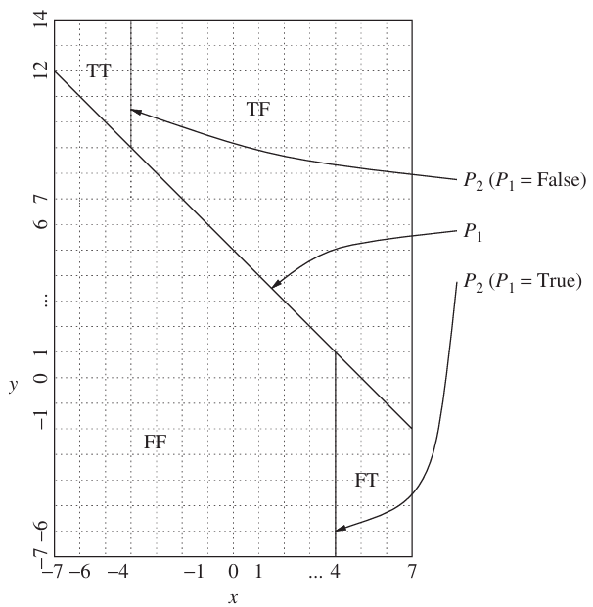
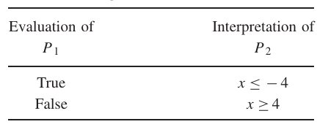
SOLUTION

Slide 20
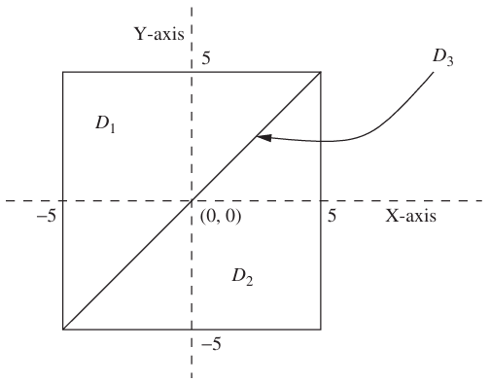
practice
Consider the three domains D1, D2, and D3 shown below. Domain D3 consists of all those points lying on the indicated straight line. Assuming that the maximum X and Y span of all the three domains are [−5, 5] and [−5, 5], respectively, give concrete values of test points for domain D3.

Slide 21
Equivalence partitioning
Equivalence partitioning is a black-box testing technique
Input data is split into partitions or classes
Each partition represents a set of values that should be treated the same by the system
EP should also applied on output instead of input only
Some requirements makes boundary of partition unclear (price <= 20 or price < 20)
Reduces number of test cases
Avoid closure error – placing (‘>=‘ instead of ‘>’)
Testing one representative value from each class is assumed sufficient
Type of partitions
Valid Equivalence Partition (vEP)
Invalid Equivalence Partition (iEP)

Slide 22
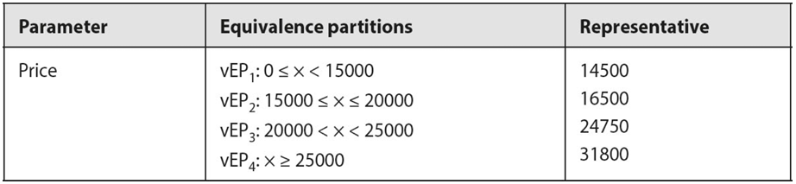
Equivalence partitioning
The software enables the manufacturer to give its dealers various discounts. The corresponding requirement reads thus:
For prices below $15,000 there is no discount. For prices up to $20,000, a discount of 5% is appropriate. If the price is below $25,000, a 7% discount is possible. If the price is above $25,000, a discount of 8.5% is to be applied. Four equivalence partitions containing valid input values (vEP) can easily be derived for calculating the discount.
Valid equivalence partition (vEP)

Slide 23
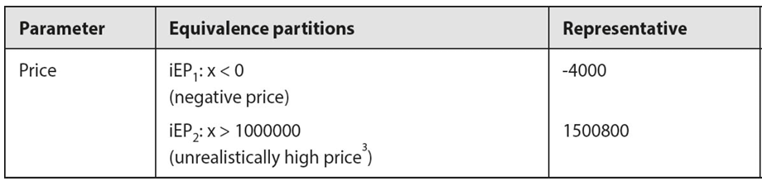
Equivalence partitioning
Invalid equivalence partitions (iEP)

Slide 24
practice
Consider a software system that computes income tax based on adjusted gross income (AGI) according to the following rules
If AGI is between $1 and $29,500, the tax due is 22% of AGI.
If AGI is between $29,501 and $58,500, the tax due is 27% of AGI.
If AGI is between $58,501 and $100 billion, the tax due is 36% of AGI.

Slide 25
Solution
There are three input conditions:
Condition 1: $1 ≤ AGI ≤ $29,500
Condition 2: $29,501 ≤ AGI ≤ $58,500
Condition 3: $58,501 ≤ AGI ≤ $100 billion
First we consider condition 1 to derive two ECs:
EC1: $1≤ AGI ≤ $29,500; valid input.
EC2: AGI < 1; invalid input
Then, we consider condition 2 to derive on EC:
EC3: $29,501 ≤ AGI ≤ $58,500; valid input
Finally, we consider condition 3 to derive two ECs:
EC4: $58,501 ≤ AGI ≤ $100 billion; valid input.
EC5: AGI > $100 billion; invalid input.

Slide 26
Coverage
An exit criteria can be defined by the relationship between number of tested values and the total number of equivalence partitions:
EP coverage = (Number of tested EPs / total number of EPs) x 100%
If 15 test cases are executed on 18 partitions, coverage will be:
EP coverage = (15/18) x 100% = 83.33%

Slide 27
Boundary value analysis
BVA complements equivalence partitioning by focusing on values at the edges (boundaries) of valid and invalid input ranges
Many bugs tend to cluster at boundaries due to off-by-one errors or incorrect comparison operators
BVA is only applicable when the input data can be ordered (numerically or logically)
For each boundary, three values are tested:
The exact boundary value
One value just inside
One value just outside
−10.0 ≤ X ≤ 10.0 = {−9.9 −10.0,−10.1} and {9.9,10.0,10.1}

Slide 28
Example
Let us consider the five ECs identified in our previous example to compute income tax based on AGI. The BVA technique results in test as follows for each EC. The redundant data points may be eliminated.
EC1: $1≤ AGI ≤ $29,500; This would result in values of $1, $0, $–1, $1.50 and $29,499.50, $29,500, $29,500.50.
EC2: AGI < 1; This would result in values of $1, $0, $–1, $–100 billion.
EC3: $29,501 ≤ AGI ≤ $58,500; This would result in values of $29,500, $29,500.50, $29,501, $58,499, $58,500, $58,500.50, $58,501.
EC4: $58,501 ≤ AGI ≤$100 billion; This would result in values of $58,500, $58,500.50, $58,501, $100 billion, $101 billion.
EC5: AGI > $100 billion; This would result in $100 billion, $101 billion, $10000 billion

Slide 29
Coverage
An exit criteria can be defined by the relationship between number of tested values and the total number of BVs:
BV coverage = (Number of tested BV / total number of BV) x 100%
If 15 test cases are executed on 18 BVs, coverage will be:
BV coverage = (15/18) x 100% = 83.33%

Slide 30
State transition testing
Black-box testing technique which focuses on
The behavior of the system as it moves from one state to another
The history of system inputs and actions, not just current input data
Useful when system has finite number of states and output depends on prior events
A state machine has
Finite number of states
Events/inputs that trigger transitions between states
Action tied to transitions
Deterministic behavior (same input each time, same output)
Guard conditions are useful when multiple transitions are possible from a state, guard conditions define which one to take

Slide 31
State transition testing Cont..
Coverage criteria can be identified based on the available resources whether all states are required to test or only subset of critical state
N-switch coverage measures depth of test sequences
0-switch – one transition
1-switch – two transitions
2-switch – three transitions
Useful for testing loops/cycles in state machines
State transition testing can be used to test GUIs where each mask/dialog will be a state and user interaction (click, input) will be an event or transition

Slide 32
Example
The vehicle support over-the-air (OTA) software updates, which can only occur when engine is off.
Engine OFF – Default idle state
Engine ON – Active driving state
Update MODE – State during OTA update
System enters Engine OFF state if battery is sufficient
System shuts down if the battery is depleted

Slide 33
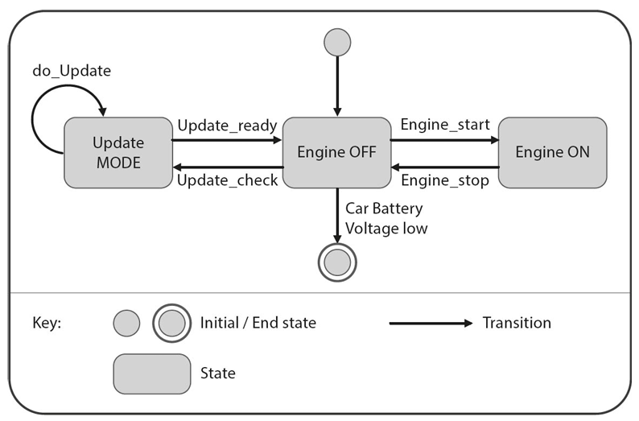
State machine for a vehicle software update

Slide 34
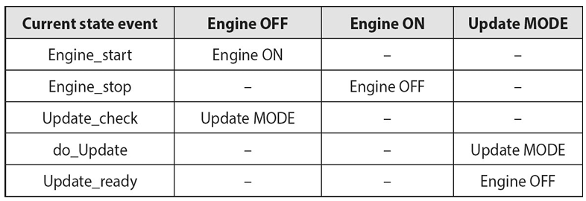
State transition table for a vehicle software update

Slide 35
Decision table testing
Focus on combinations of input conditions and their effects
EP and BVA only focuses on individual input instead of combination of input
Decision table can be drawn directly or with the help of cause and effect diagram
Upper left – Conditions
Upper right – All combinations of conditions
Lower left – Actions
Lower right – which actions occur for each combination
To create decision table
Identify all conditions and actions
List all combinations of conditions (2n for n conditions)
Determine what actions follow each combination
Remove redundant columns

Slide 36
Example
Create decision table for the given scenario:
A special offer for a limited period is aimed at increasing vehicle sales. All standard models receive an 8% discount and all special editions (for which no optional extras are available) a 10% discount. If more than three extras are selected for a standard model, these receive an additional 15% discount. All other models receive no additional base discount and no extra discount for additional extras.

Slide 37
Solution
Conditions
Is it a standard model?
Is it a special edition?
Are more than 3 extras selected?
Actions
8% discount
10% discount
15% discount
No discount

Slide 38
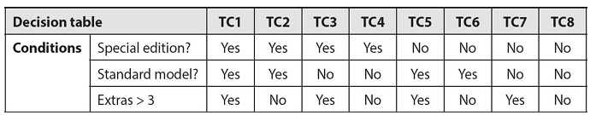
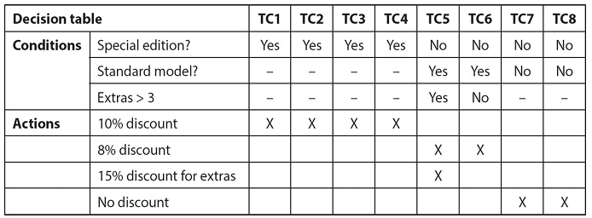
Solution cont..
Upper part of the decision table showing all combinations of conditions
Decision table including “don’t care” cases

Slide 39
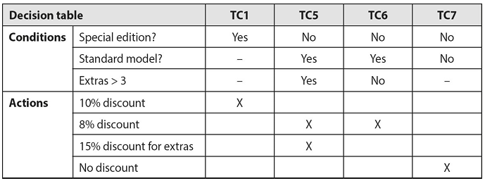
Solution cont..
The table can now be consolidated. Test cases 1-4 are identical and can be treated as one, as can test cases 7 and 8.
The result is the following decision table with 4 columns for 4 test cases

Slide 40
Decision table using cause-effect graphing
A cause-effect graph is a formal language into which a natural-language specification is translated
In order to create cause effect graph, follow the steps:
Break down the specification
Identify causes and effects
Build the Boolean graph
Add constraints (optional)
Convert to decision table
Generate test cases

Slide 41
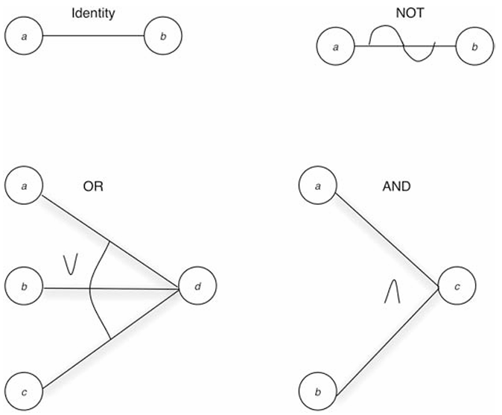
Identity (a → b): If a = 1, then b = 1; else b = 0
NOT: If a = 1, then b = 0; else b = 1
OR: If any input is 1, output is 1
AND: If all inputs are 1, output is 1

Slide 42
Example
Generate cause-effect graph for the given scenario:
The character in column 1 must be an ‘‘A’’ or a ‘‘B.’’ The character in column 2 must be a digit. In this situation, the file update is made. If the first character is incorrect, message X12 is issued. If the second character is not a digit, message X13 is issued.

Slide 43
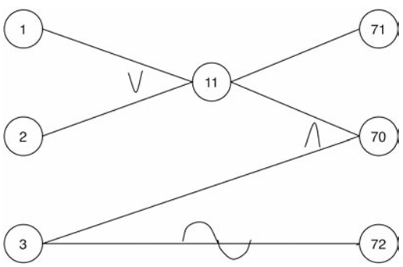
Solution
The causes are
1—character in column 1 is ‘‘A’’
2—character in column 1 is ‘‘B’’
3—character in column 2 is a digit
and the effects are
70—update made
71—message X12 is issued
72—message X13 is issued

Slide 44
Example
Consider the withdrawing cash from an ATM scenario and draw cause-effect diagram and decision table:
Conditions:
The customer’s card is valid
The correct PIN is entered
A maximum of three PIN input attempts is allowed
Money is available (in the account and in the ATM)
The possible (re)actions of the ATM are as follows:
The card is rejected
The user is asked to re-enter the PIN
The card is confiscated
The user is asked to enter a different sum of money
Money is paid out

Slide 45
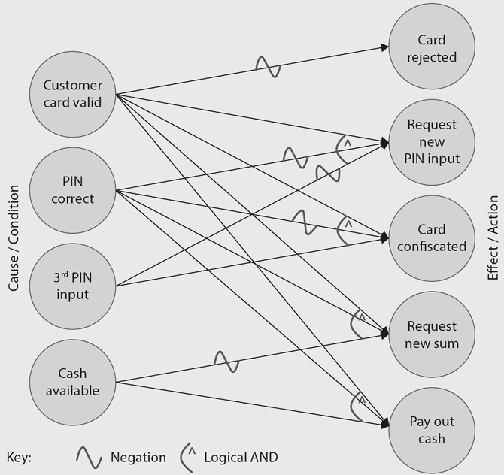
solution

Slide 46
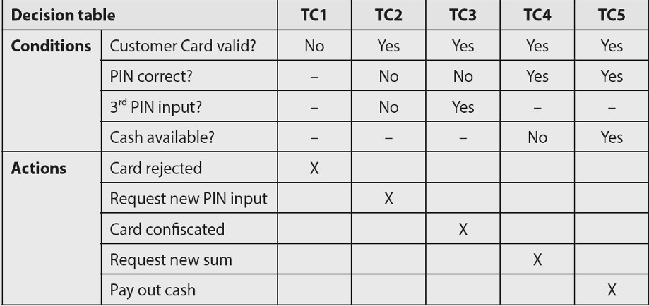
solution

Slide 47
Pairwise testing
Each possible combination of values for every pair of input variables is covered by at least one test case
Test every possible pair of input parameter values at least once
Most bugs are caused by the interaction of two parameters rather than all of them together
For 3x3 Boolean input (A, B, C), there are 8 total combinations
With pairwise testing, only 4 combinations might suffice if each pair (A-B, B-C, A-C) covers all 2x2 value combinations
Orthogonal array – Every pair occurs same number of times (large)
Covering array – every pair occurs at least once (small)

Slide 48
N-wise testing
Generalization of pair-wise: test combinations of n parameters at a time
For example, testing all 3-way combinations (n=3) would cover failures that occur due to interactions between three parameters
Objective of pairwise testing is to identify failures that occur due to the interaction of pairs of parameters
Inputs: 10 models, 5 engines, 10 rims × 2 tire types, 10 colors × 3 paint effects, 5 entertainment systems
Total combinations: 150,000
Testing all the possible variants would take 1.7 days of testing time

Slide 49
N-wise testing Cont..
Higher value of n increases number of test cases that have to be designed and executed
In order to achieve 100% coverage, all test cases have to be executed
If the value of n is very high, achieving 100% coverage involves a lot of effort and often is not a practical solution
Solution: Increase n by 1 once a failure has been discovered and remedied, and to repeat the process until no more failures occur on the next level up

Slide 50
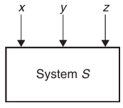
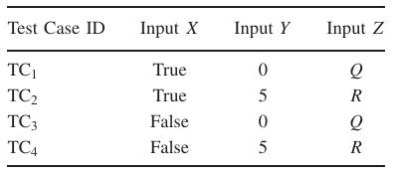
Example
Consider the system S, which has three input variables X,Y, and Z. Let the notation D(w) denote the set of values for an arbitrary variable ‘w’. For the three given variables X, Y, and Z, their value sets are as follows:
D(X)={True, False}, D(Y) ={0,5}, and D(Z) ={Q,R}
Pairwise test cases for system S

Slide 51
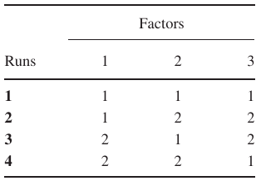
Example cont..
Choose any two columns at random and find all pairs (not all combinations of 1’s and 2’s). This is an example of L4(2³) orthogonal array. The 4 indicates 4 rows (runs), 2³ indicates 3 columns (factors), number of possible values in a column (level)
Orthogonal arrays are denoted by LRuns (Levels^{Factors})
L4(2³) orthogonal array

Slide 52
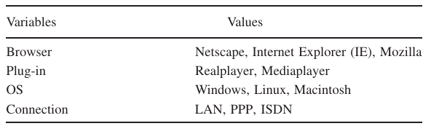
Example
Consider a website that is viewed on a number of browsers with various plug-ins and operating systems (OSs) and through different connections as shown in Table below. The table shows the variables and their values that are used as elements of the orthogonal array. We need to test the system with different combinations of the input values
Various values that need to be tested in combination

Slide 53
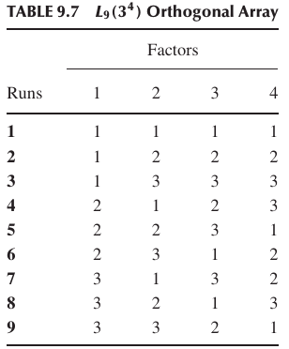
Solution
Map the variables to the factors and values to the levels of the array: The factor 1 to Browser, the factor 2 to Plug-in, the factor 3 to OS, and the factor 4 to Connection. Let 1 = Netscape, 2 = IE, and 3 = Mozilla in the Browser column. In the Plug-in column, let 1 = Real player and 3 = Media player. Let 1=Windows, 2=Linux, and3=Macintosh in the OS column. Let 1 = LAN, 2 = PPP, and 3 = ISDN in the Connection column

Slide 54
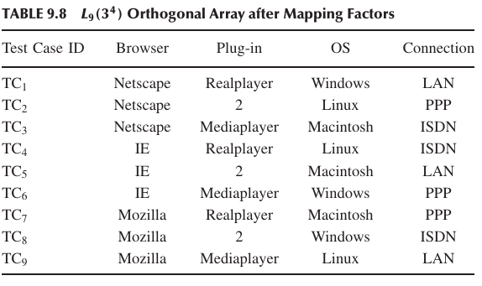
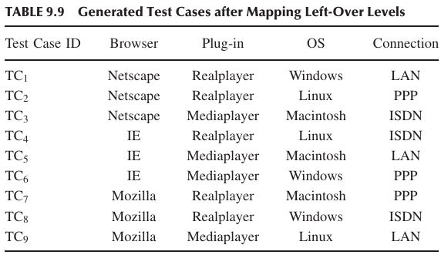
Solution cont..
Start at the top of the Plug-in column and cycle through the possible values when filling in the left-over levels

Slide 55
Use case testing
Use cases describe interactions between a user (or external system) and the system under test (SUT)
Used for identifying and documenting system requirements
Commonly illustrated using use case diagrams, which depict typical user/system interaction
Useful for system testing, acceptance testing and occasionally for integration testing
Use case includes
Preconditions – must be true before execution (e.g. customer must logged in)
Post conditions – outcomes after use case runs (e.g. order placed)
Use cases represents normal behavior and alternatives

Slide 56
Use case testing Cont..
Ideal for checking typical user scenarios
Helps verify that the system behaves correctly under normal conditions
Test cases should cover
All main flows
All alternatives (e.g. ‘extend’ paths)
Test design requires
Initial state and preconditions
Constraints
Expected outcome and post conditions
Exit criteria is that every use case must be covered by at least one or more test cases

Slide 57
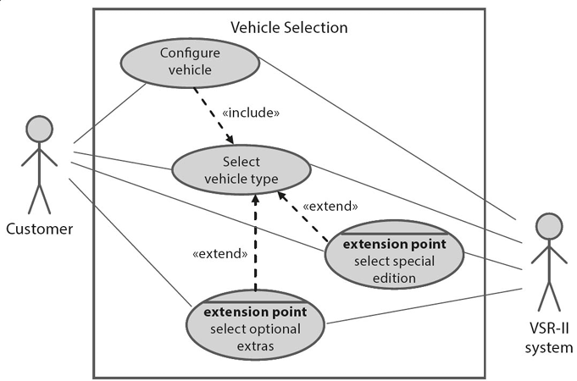
Use case testing Cont..
To configure a vehicle, a customer has to select a vehicle type. Once this has happened, there are three alternative ways to proceed. The customer can select a special edition, optional extras, or neither of these.

Slide 58
Other black box testing techniques
Syntax Testing
Random Testing
Smoke Testing

Slide 59
Syntax Testing
Ensures the system accepts valid input formats and rejects incorrect ones
Based on formally defined syntax rules (grammar rules, data formats)
Example: Testing whether a form rejects improperly formatted email addresses

Slide 60
Random Testing
Checks system reliability using randomly chosen inputs
Random values are selected (ideally with a statistical distribution like normal distribution)
Helps find unexpected system behavior under varied input conditions

Slide 61
smoke Testing
Quickly checks if the system’s core functions work and it doesn’t crash
Runs a basic set of tests, often automated and reused
Performed early, especially after builds/updates, to decide if deeper testing is worth proceeding with
Named after the idea that if it “doesn’t go up in smoke”, it might be usable!

Slide 62
More on Black box testing
+ Focuses on user-facing functionality
+ Ensures the system behaves as expected in common usage scenarios
+ Essential for system and acceptance testing

Slide 63
More on Black box testing
- If the requirements themselves are wrong, black-box testing won’t catch it
- The system may pass tests based on incorrect assumptions
- Only verifies what’s explicitly stated, not what might be unintentionally present
- Primarily checks functional correctness, no internal structure or code quality
- Doesn’t assess how well code is written – just it works

Slide 64
White box testing
Focus on the structure and behavior within the test object
Also known as structured-based testing or code-related testing
The point of observation (PoC) lies within the test object
Test cases can be derived from the structure of the application’s code or specification
Objective is to
Verify a specified degree of structural coverage i.e. 80% of the statements in the test object need to be covered by test cases
Ensure every individual statement in code runs at least once

Slide 65
White box testing cont..
We can differentiate between different types of white-box test techniques:
Statement Testing
Decision Testing
Condition Testing
Branch condition testing
Branch condition combination testing
Modified condition decision coverage testing
Path Testing

Slide 66
Statement testing
White box testing technique that focuses on executing each individual statement in the program at least once
The goal is to ensure that all code lines are tested and checked for correctness
Control flow graph is created from code
Nodes – statements
Edges – control flow (path between statements)
Unconditional statements are grouped into a single node

Slide 67
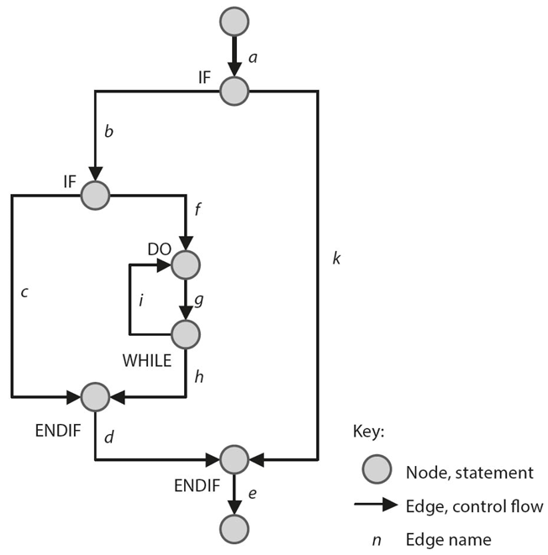
This example is based on a simple piece of code that contains just two IF-statements and a single loop
The test case has to traverse all the edges in the following order:
a, b, f, g, h, d, e

Slide 68
Statement testing cont..
The exit criteria for this type of test can be clearly defined using the following formula:
Statement coverage = (number of executed statements / total number of statements)×100%
This is called C0 Coverage
It’s considered a basic/weak form of code coverage
Testers aim for 100%, but in practice, some unreachable code may make this impossible without excessive effort

Slide 69
Decision testing
Ensure that each possible decision outcome (True/False) in code is tested
Each decision (IF, CASE, loop) creates branches (edges in control flow)
Tests must cover all edges (all possible decision outcomes)
Decision Coverage = (Tested Decision Outcomes / Total Decision Outcomes) x 100%
This is called C1 coverage
Decision testing detects missing logic in IF/ELSE branches
Better for identifying logic errors than C0
Requires more test cases than statement testing

Slide 70
condition testing
Branch Condition Testing
Branch Condition Combination Testing
Modified Condition Decision Coverage

Slide 71
Branch condition testing
Evaluate each atomic condition (e.g. x > 3, not x > 3 OR y < 5) for both true and false
Does not guarantee different outcomes of the full decision and hence weaker than decision testing
Example:
For x > 3 OR y < 5:
Test x = 6, y = 8 → T OR F → T
Test x = 2, y = 3 → F OR T → T
Both result in T, so we don't know if a bug would affect the overall logic.

Slide 72
Branch condition combination testing
Test all combinations of conditions in a decision
Subsumes statement and decision testing. Ensures all logical combinations are exercised
Downside – exponential growth 2n combinations for n conditions
Not all combinations may be realizable due to logical constraints

Slide 73
Branch condition combination testing
Condition: x > 3 OR y < 5
Example (unrealizable):
For 3 ≤ x AND x < 5, you can’t test (F, F) since a number can't be both < 3 and ≥ 5.
Example (realizable)
x = 6 (T), y = 3 (T), x > 3 OR y < 5 (T)
x = 6 (T), y = 8 (F), x > 3 OR y < 5 (T)
x = 2 (F), y = 3 (T), x > 3 OR y < 5 (T)
x = 2 (F), y = 8 (F), x > 3 OR y < 5 (F)

Slide 74
Modified condition decision coverage
For each condition, ensure that changing its value alone causes a change in the overall decision
Tests only combinations that matter (affect the outcome)
More efficient than full combination testing
Preferred for compound decisions
Example:
For x > 3 OR y < 5:
x = 6, y = 8 → T OR F → T
x = 2, y = 3 → F OR T → T
x = 2, y = 8 → F OR F → F

Slide 75
Path testing
Ensures that all possible execution paths through a program are tested
This is more rigorous than statement or branch testing because it covers all combinations of branches and loops
In simple statement or branch testing, loops might be executed once or not at all
Path testing forces you to test
Loop not taken
Loop taken once
Loop taken multiple times
This is crucial because bugs often appears under repeated execution conditions

Slide 76
double calculate_price(double baseprice, double specialprice, double extraprice, int extras, double discount) {
double addon_discount, result;
if (extras ≥ 3)
addon_discount = 10;
else
if (extras ≥ 5)
addon_discount = 15;
else
addon_discount = 0;
if (discount > addon_discount)
addon_discount = discount;
result = baseprice/100.0 * (100-discount) + specialprice + extraprice/100.0 * (100-addon_discount);
return result;
}

Slide 77
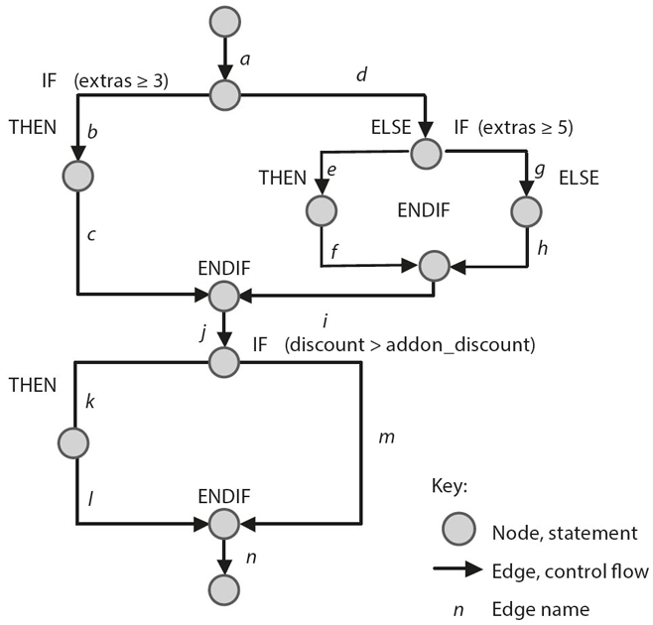

Slide 78
Path testing cont..
Test Case 1
price = calculate_price(10000.00,2000.00,1000.00,3,0);
test_ok = test_ok && (abs (price-12900.00) < 0.01);
Test Case 2
price = calculate_price(25500.00,3450.00,6000.00,6,0);
test_ok = test_ok && (abs (price-34050.00) < 0.01);
These test cases cause the following paths through the graph to be executed:
Test case 01: a, b, c, j, m, n
Test case 02: a, b, c, j, m, n
These test cases only execute two out of six possible decision outcomes, thus achieving 33% decision coverage (and 6/14, or 43% branch coverage)

Slide 79
Path testing cont..
To improve coverage, following test cases are specified
Test Case 03
price = calculate_price(10000.00,2000.00,1000.00,0,10);
test_ok = test_ok && (abs (price-12000.00) < 0.01);
Test Case 04
price = calculate_price(25500.00,3450.00,6000.00,6,15);
test_ok = test_ok && (abs (price-30225.00) < 0.01);
These test cases cause the following paths through the graph to be executed:
Test case 03: a, d, g, h, i, j, k, l,
Test case 04: a, b, c, j, k, l, n
These test cases also execute the edges d, g, h, i, k, and l, and thus increase coverage to 5/6 decision outcomes = 83% (and branch coverage of 12/14 = 86%). In this case, edges e and f are not executed.

Slide 80
Experience based testing
Leverage the know-how and experience of testers, developers, users and other stakeholders to design test cases, test conditions and test data
Degree of coverage is difficult to ascertain and therefore cannot be effectively used as an exit criteria
Often used in conjunction with black and white box testing

Slide 81
Intuitive test case derivation
A non-methodical approach to test case design
Relies on tester’s intuition, experience and knowledge
Often referred to as error guessing
Test cases are designed based on
Past experience with defects
Knowledge of common developer mistakes
Insight into system weaknesses
No formal rules or steps
Tester guesses where error might be based on
Past issues in similar systems
Frequently misused functionalities
Helpful when documentation is limited

Slide 82
Check list based testing
Track past bugs, failures, and edge cases
Update regularly with new experiences
Helps in
Avoiding repeated bugs
Creating better test cases
Remind the tester to cover all aspects
Coverage – how many checklists are tested
Use checklists to derive test cases
Build and maintain checklists overtime

Slide 83
exploratory testing
Used when no proper documentation and more time available
No predefined plan, tests evolve as knowledge grows
Elements of test object and their tasks and functions are ‘explored’ before deciding which elements to test
A virtual model of the system is built in the tester’s mind
Helps in identifying unexpected behavior
Drives new tests based on earlier results
Not a primary (formal) testing technique
VSR-II testers used the knowledge from testing older versions (VSR-I)

Slide 84
Session based exploratory testing
Uses time-boxing (e.g. 90 minutes per session)
Each session has
A goal (called a ‘Test Charter’)
Defined scope and focus
All finding recorded in session sheets
Each test charter should answer
Why are we testing?
What are we testing?
How are we testing?
What problems are we looking for?

Slide 85
Choosing right testing technique
Many testing techniques exist – which one to use and when?
Some techniques are better suited for specific test levels
Its better to combine techniques for
Better coverage
Efficient use of time and budget
Techniques vary from informal to formal

Slide 86
Choosing right testing technique
Choosing the right technique depends on
Project needs
Team skills
Regulations
Time and budget
Risk level
Development model

Slide 87
Choosing right testing technique
1. Type of test object
Component level
Use black-box and white box techniques
System level
Use use-case or state-transition testing
User interface
Focus on non-functional tests like usability
2. Complexity of the system
Simple logic: Basic decision testing is enough
Complex logic: Requires compound condition testing
More complexity – more thorough technique required

Slide 88
Choosing right testing technique
3. Adherence to standards
Some industries mandate specific techniques
Especially in safety-critical or regulated environments
Often includes coverage requirements (e.g., 100%)
4. Customer or contractual requirements
Customers may demand:
Specific techniques
Minimum test coverage
Ensures smoother acceptance testing

Slide 89
Choosing right testing technique
5. Testing objectives
Objectives may include:
Correctness
Completeness
Architecture validation
Choose techniques that align with specific goals
6. Risk Analysis
High-risk components need:
More testing
Diverse techniques
Lower-risk – possibly simpler testing.

Slide 90
Choosing right testing technique
7. Planned software usage
Example:
Simple web form = light testing
Hospital power control system = intensive testing
Usage risk guides the depth and variety of testing
8. Available documentation
Good specs: Can automate test design
No/poor docs: Use exploratory testing to learn & test

Slide 91
Choosing right testing technique
9. Available tools
Tools help with:
Test case design
Execution
Defect tracking
Choose tool-supported techniques for efficiency
10. Knowledge and skills
Choose techniques the team is skilled in
If not, provide training
Creative testers may prefer exploratory testing

Slide 92
Choosing right testing technique
11. Types of expected faults
Anticipate error types
Example: Range errors → Use boundary value analysis
Matching technique to likely fault – better detection
12. Development model
Agile: Needs frequent, automated tests.
V-model: Predefined levels → apply specific techniques at each level.

Slide 93
Choosing right testing technique
13. Time and budget constraints
Limited resources – Pick efficient techniques
Automation can save time and money

Slide 94
conclusion
Correct functionality is of central importance to any software system, so thorough testing of the test object’s functionality needs to be guaranteed
No one-size-fits-all technique exist in testing different aspects
Using equivalence partitioning and boundary value to derive test cases is recommended for every test object
If dependencies between input values need to be tested, use decision tables to document the dependencies and derive appropriate test cases
On the system testing level, use cases can be used as a basis for deriving test cases
White-box techniques are best applied to low-level tests, while black-box techniques can be applied on all levels

